Slide 1

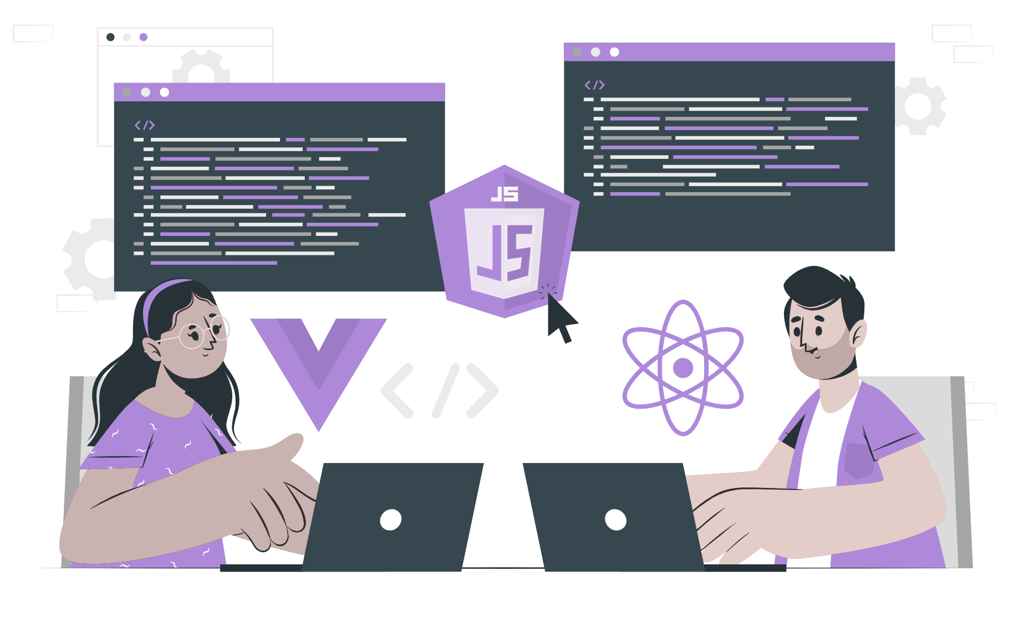
How to handle different URLs

Slide 2
Topics
What are URLs
What are the different parts of URL
How to handle different URLs in Node.js

Slide 3
What are URLs
URLs stand for Uniform Resource Location, commonly termed as a web address
is a reference to a web resource that specifies its location on a computer network and a mechanism for retrieving it.
Uniform Resource Locators were defined in RFC 1738 in 1994 by Tim Berners-Lee
URLs occur most commonly reference web pages (HTTP) but are also used for file transfer (FTP), email(mailto), database access and many other application.

Slide 4
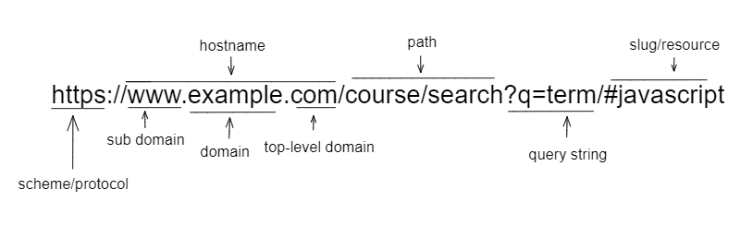
What are different parts of URL

Slide 5
Continue ...
URLs is composed of several fails, including
Scheme - The scheme indicates the protocol used to access the resource
HostName - the hostname is the name of the server hosting the resource
Port - the port number is an optional part of the URL that specifies the network port to use for the connection.
Path - it specifies the location of the resource on the server
Query - the query string is an optional part of the URL that contains data to be passed to the server
Slug -it can be called a resource or fragment which is an optional part of the URL

Slide 6
How to handle different URLs in Node.js
In Nodejs, different URLs can be handle using conditional statement and http module.
Example:
const http = require("node:http");
const port = 3000; // port declaration
const host = "localhost"; // host name declaration
// create server with http.createServer
const server = http.createServer((req, res) => {
// conditional statement for handling route
if (req.url === "/") {
res.write("Hello, world!");
res.end();
} else if (req.url === "/about") {
res.write("About page");
res.end();
} else if (req.url === "/contact") {
res.write("Contact us");
res.end();
} else {
res.write("Page not found");
res.end();
}
});
// server listen on port
server.listen(port, () => {
console.log(`Server up at ${host}:${port}`);
});

Slide 7
continue…
// output -
http://localhost:3000/
hello world
http://localhost:3000/about
About page
http://localhost:3000/contact
Contact Us
http://localhost:3000/*
Page not found
Different URLs can also be handle using third party library or package like Express, which we will look further in the next topic i.e Express.

Slide 8
THANK YOU

